Slide 1
2 Data Visualization
by evan li

Slide 2
Agenda
• Homework review & Recap
• What is Data Visualization?Why do we do it?
• A first example of it
• Tools we are gonna use
• More advanced example
• Data Visualization on SF crime

Slide 3
Homework Review
Read <<The discipline of Machine learning>>,Write a critique. 500 words.
Download SF Crime Classification Dataset to your own cloud and start explore it.
Set up the project directory.
Type all the code again.

Slide 4
Recap
What is Machine Learning?
Applications
Formal Definition
Data point of view
industry point of view
Supervised Learning vs Un-Supervised Learning
Supervised Learning: Classification
What is Classification Problem?
A typical Pipeline

Slide 5
Data Visualization
Data Visualization is the most effective and intuitive way to explore the dataset in a machine learning problem.
While making graphs and tables for the raw data, we are gaining insight about the dataset.

Slide 6

Data Visualization Comes firstly
Data Vis
Understand problem
Choose features
Choose models
Training With real data
Decide the way to improve
Check the goodness of fit
Perform the prediction

Slide 7
Preprocess Data
Text to numeric
scale
calculate summary stats
…etc

Slide 8
Visualization Tools
matplot
seaborn

Slide 9
Techniques used in data exploration
data visualization
min/max/median
histogram
clustering
read raw data and feel

Slide 10
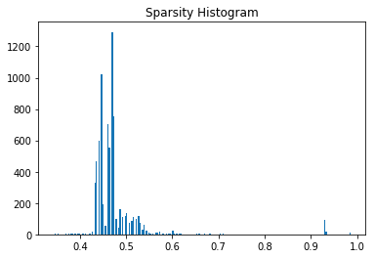
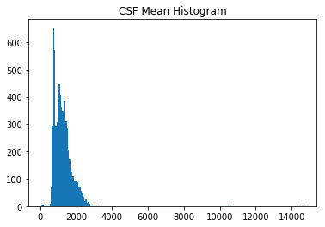
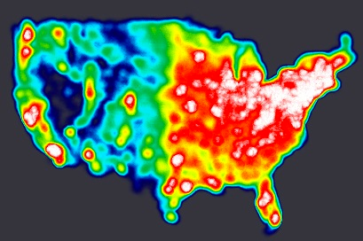
Techniques used in data exploration

Slide 11
Code Run through in notebook

Slide 12
Homework
Write your own Data Visualization program based on SF crime dataset and lecture notebook.
Add description for what you are visualizing and how does this image could help predict crime.

